Slide 1



Digital portfolio
SANJAY J

Slide 2



agenda
Introduction​
Problem Statement
Project Overview
Tools and Technology
Features and Functionality
Results and Screenshot
Conclusion

Slide 3


Introduction
I am Sanjay J, a passionate web developer with skills in HTML, CSS, JavaScript, Bootstrap, and Git, and this portfolio showcases the projects I have built and the knowledge I have gained in web development.

Slide 4

Problem statement
Click to add photo
Many individuals and businesses lack an online presence, making it hard to showcase their work or services. This portfolio aims to solve that by demonstrating how websites can be effectively designed and developed to represent skills, projects, and personal branding.

Slide 5

Project overview​
This digital portfolio is a personal website that showcases my skills, projects, and experience in web development. It is designed using HTML, CSS, and JavaScript to create a clean, responsive, and user-friendly interface. The portfolio highlights my best work and helps me present my abilities to potential clients or employers effectively.

Slide 6
Tools and technology
tools
technology
I used HTML, CSS, and JavaScript to build the website, Bootstrap for responsiveness, Git & GitHub for version control, and Visual Studio Code as my code editor.
I used HTML to create the structure of the website, CSS for styling and layout, and JavaScript to add interactivity. Bootstrap was used to make the design responsive on different devices. For version control and collaboration, I used Git and GitHub. All coding and development were done using Visual Studio Code.

Slide 7


Features and functionality
Responsive design that works on all devices
Easy navigation with a clean layout
Showcase of projects with images and descriptions
Contact form for easy communication
Interactive elements using JavaScript
Links to my GitHub and social profiles.

Slide 8
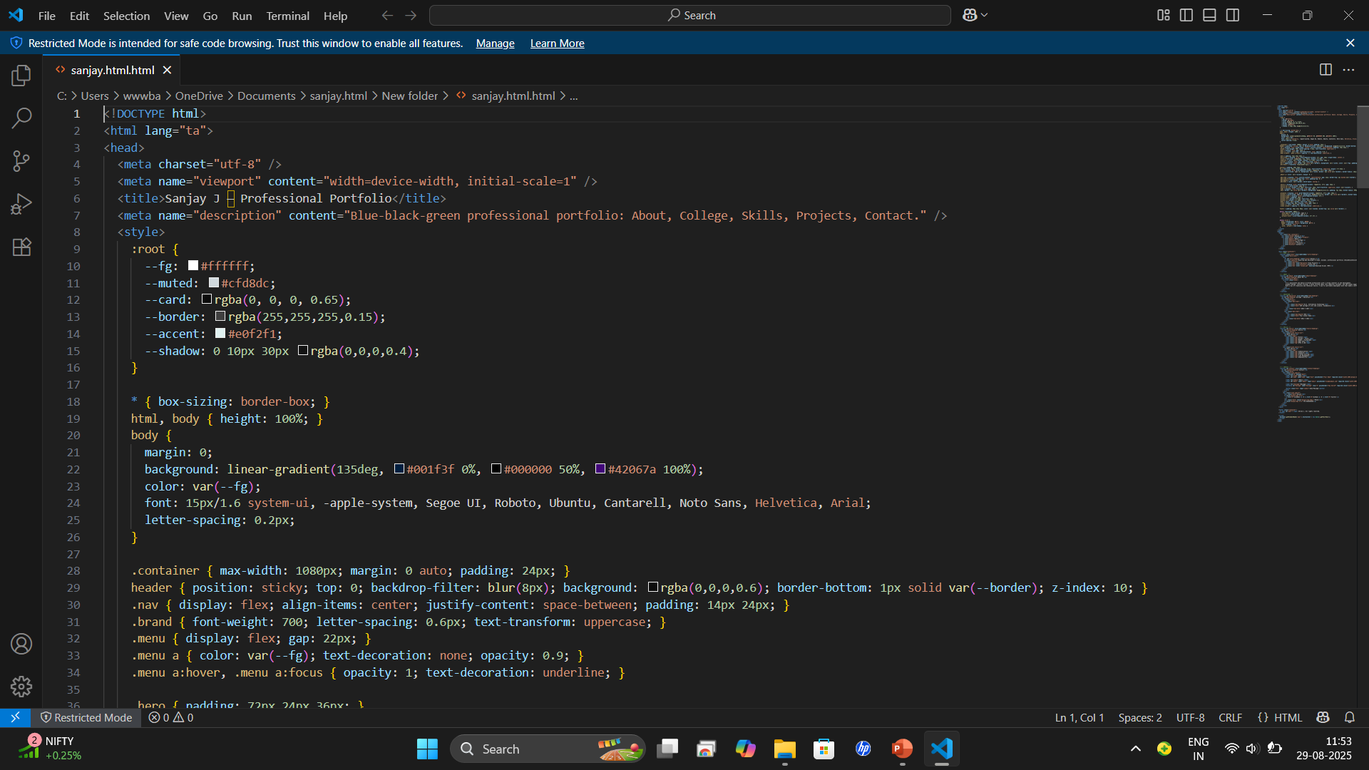
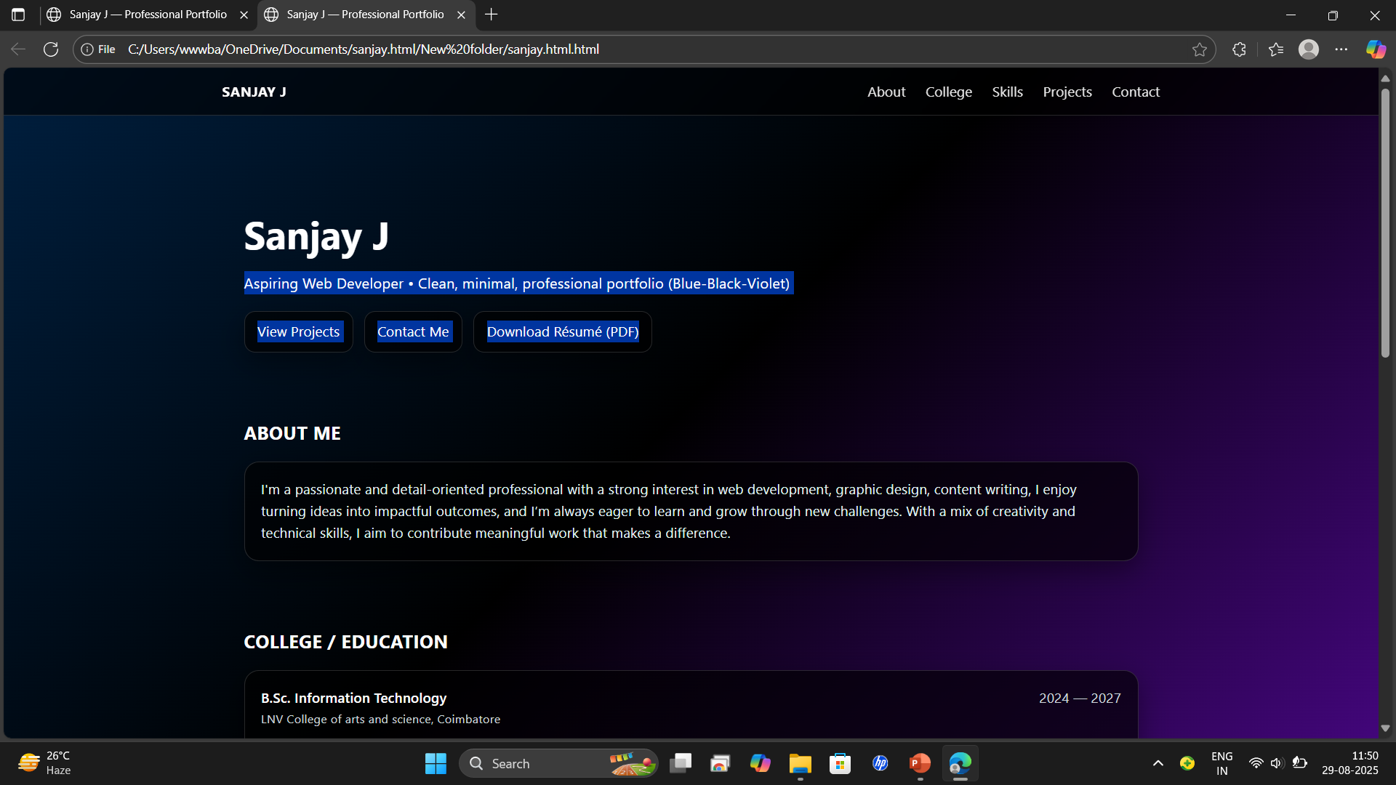
Results and screenshots
code
result

Slide 9

conclusion
This portfolio showcases my skills, experiences, and achievements so far. It reflects my growth and dedication towards continuous learning and improvement. I am motivated to face new challenges and keep advancing in my career.

Slide 10

Thank you
SANJAY J

